Slide 1
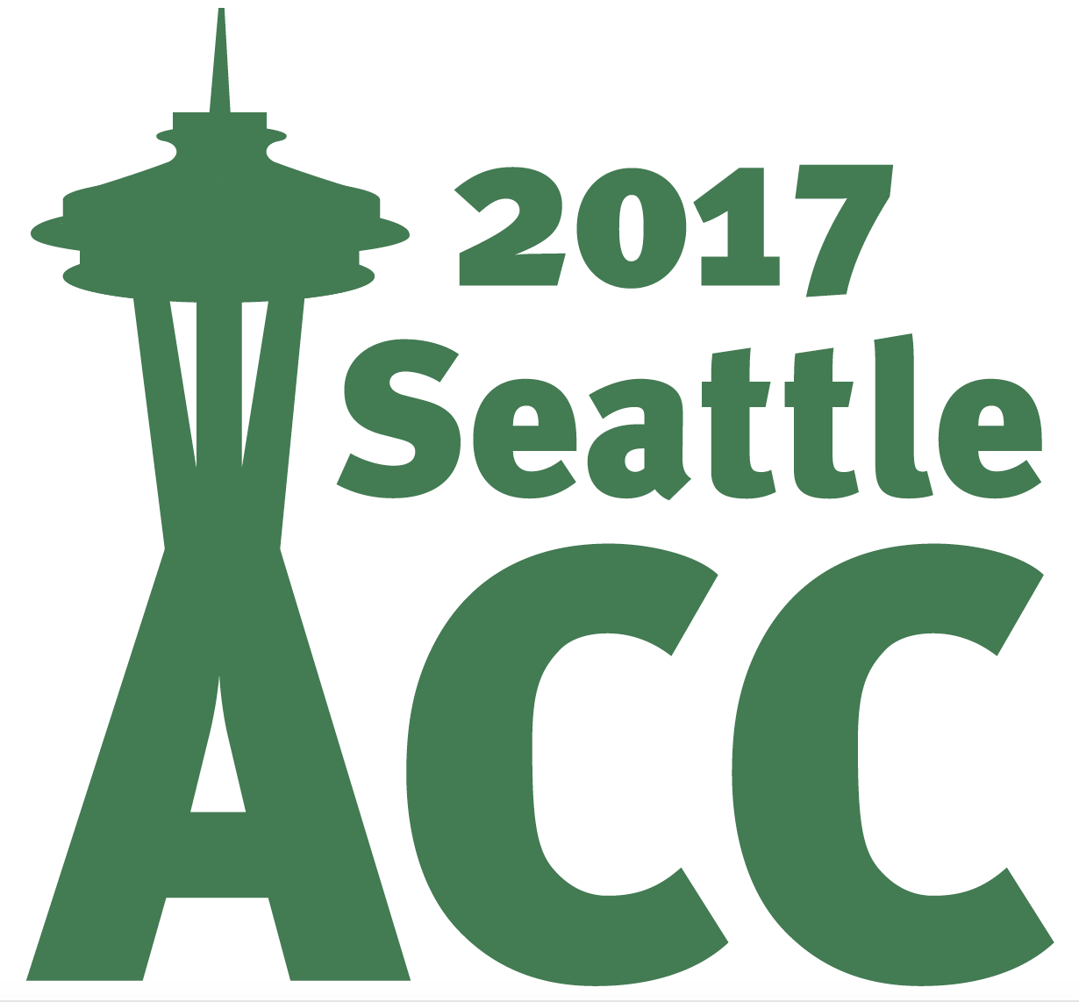
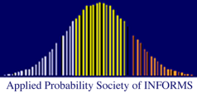
2017 AACC & ACC Awards Ceremony American Automatic Control Council 2017 American Control Conference Seattle, WA 25 May 2017

Slide 2
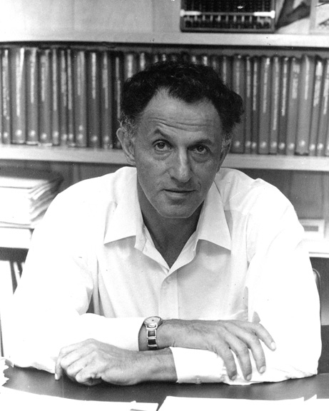
Richard E. Bellman Control Heritage Award
Richard E. Bellman (1920-1984)
Career with Princeton, RAND, USC
Pioneer in modern optimization, systems analysis, and control theory
Developed dynamic programming, invariant embedding, quasi-linearization
Published several influential books
First awarded in 1979 to Hendrik Bode
Richard Bellman was recipient in 1983

Slide 3
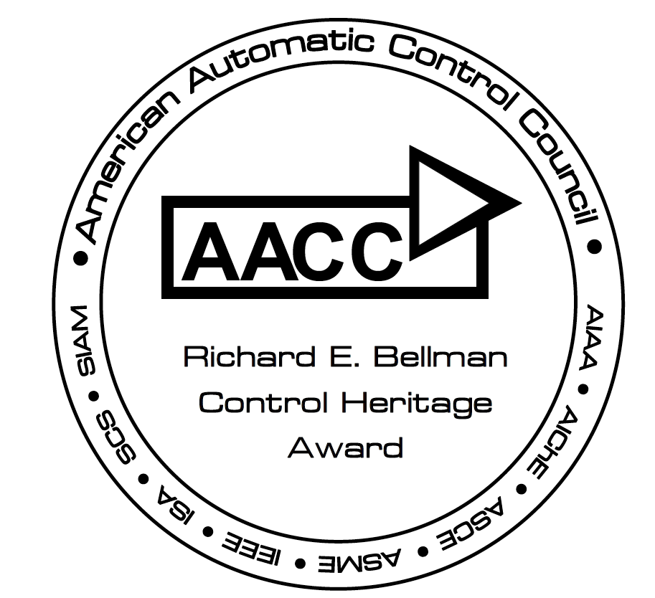
Given for distinguished career contributions to the theory or application of automatic control
It is the highest AACC recognition of professional achievement for control systems engineers and scientists
Award: plaque and an honorarium
Notes:
Note that there is a special medallion placed on the plaque

Slide 4
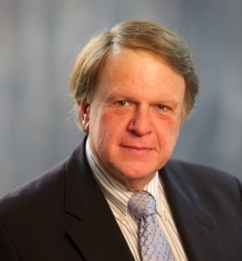
Richard E. Bellman Control Heritage Award John S. Baras
Professor
Electrical & Computer Engineering
Dept.
University of Maryland, College Park
Citation:
For innovative contributions to
control theory, stochastic systems,
and networks and academic
leadership in systems and control

