Slide 1
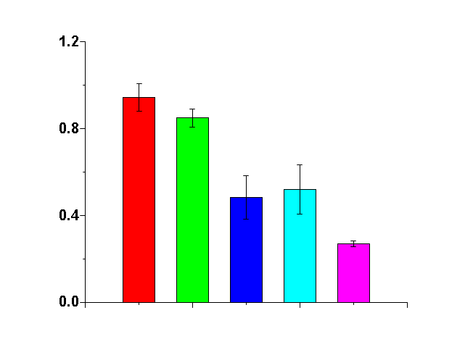
An Enhanced bacterial biofilm treatment using superpositioned electric field
Young Wook Kim^{1,2}, Hadar Ben-Yoav^{1,2}, Hsuan-Chen Wu³, David Quan³, Karen Carter³, Mariana T. Meyer^{1,3}
William E. Bentley³, and Reza Ghodssi ^{1,2,3}
¹MEMS Sensors and Actuators Laboratory, Institute for Systems Research
²Department of Electrical and Computer Engineering, ³Fischell Department of Bioengineering
University of Maryland, College Park, MD 20742, USA
Introduction
Results
- Biofilm is comprised of a dense matrix of bacterial cells, polysaccharides, and exoproteins. Frequently cause recalcitrant infections of medical implants, urinary and respiratory tracts.
- Density of biofilm structure limits drug diffusion, making antibiotics less effective.
- Develop an effective biocompatible biofilm treatment method with low dose of anitbiotic.
- Demonstrate an enhanced bioelectric effect for clinical biofilm treatment.
: Superposition of DC and AC electric fields with antibiotic showed significant improvement of biofilm treatment efficacy.
Total Biomass Quantification
After biofilm treatment with different electric field applications (AC, DC or SP field), total biomass was quantified by crystal violet staining.
Optical density (OD₅₄₀) of the stain corresponds to the biomass.
Experimental Setup
• Cuvette System
- Utilized cuvettes for Escherichia coli biofilm growth and uniform electric field applications
- PyrexTM chip to provide constant biofilm growth surface area
OD₅₄₀
Control
Antibiotic
AC-BE
DC-BE
SP-BE
Cell Viability of Biofilms After Treatments
Live bacterial cell in biofilms after treatment was quantified by colony form unit (CFU) assay
• Superpositioned Electric Field (SP field)
Electrodes are separated 4 mm in the cuvette.
Applied potential (0.5V) was lower than the threshold of media electrolysis (0.82V).
Frequency of AC component was selected based on literature.
=> SP field = 1.25V/cm DC signal+ 1.25V/cm AC signal at 10 MHz
2.5
2.6
2
1.5
Log reduction of viable bacteria
1
0.5
0.6
0
0
0.5
1
1.5
2
2.5
x 10
--7
0.2
AC-BE
DC-BE
SP-BE
Principles of Bioelectric Effect (hypothesis)
- Bacteria are composed of fully and partially charged molecules.
- DC electric field induces a non-uniform distribution of antibiotics and electrolytes.
- AC electric field increases cell membrane permeability due to local molecular vibration.
Logarithmic viable cell reduction in different treatments
Current Work
Superpositioned Bioelectric Effect Treatment
- Superposition of AC and DC electric fields in the presence of antibiotics drastically enhances biofilm treatment efficacy
- 1.25 V/cm AC signal at 10 MHz with a 1.25 V/cm DC offset with gentamicin (10 µg/mL)
Development of an integrated microsystem for biofilm detection and treatment
DC field
Bacterial cell
Concentration gradient
AC field
Bacterial cell
Antibiotic
DNA
DNA
`
`
Acknowledgements
The authors would like to thank Robert W . Deutsch Foundation and National Science Foundation Emerging Frontiers in Research and Innovation (NSF-EFRI). The authors also appreciate the support of the Maryland NanoCenter and its Fablab.
*Corresponding Author: Professor Reza Ghodssi, Tel: 301-405-8158, email:ghodssi@umd.edu
Schematic of DC field effect on bacterial cell
Schematic of AC field effect on bacterial cell

